Slide 1
Talk Shows and the Youtube Trending Page
Noor Drissi, Jason Jabbour, Harish Karamuri

Slide 2
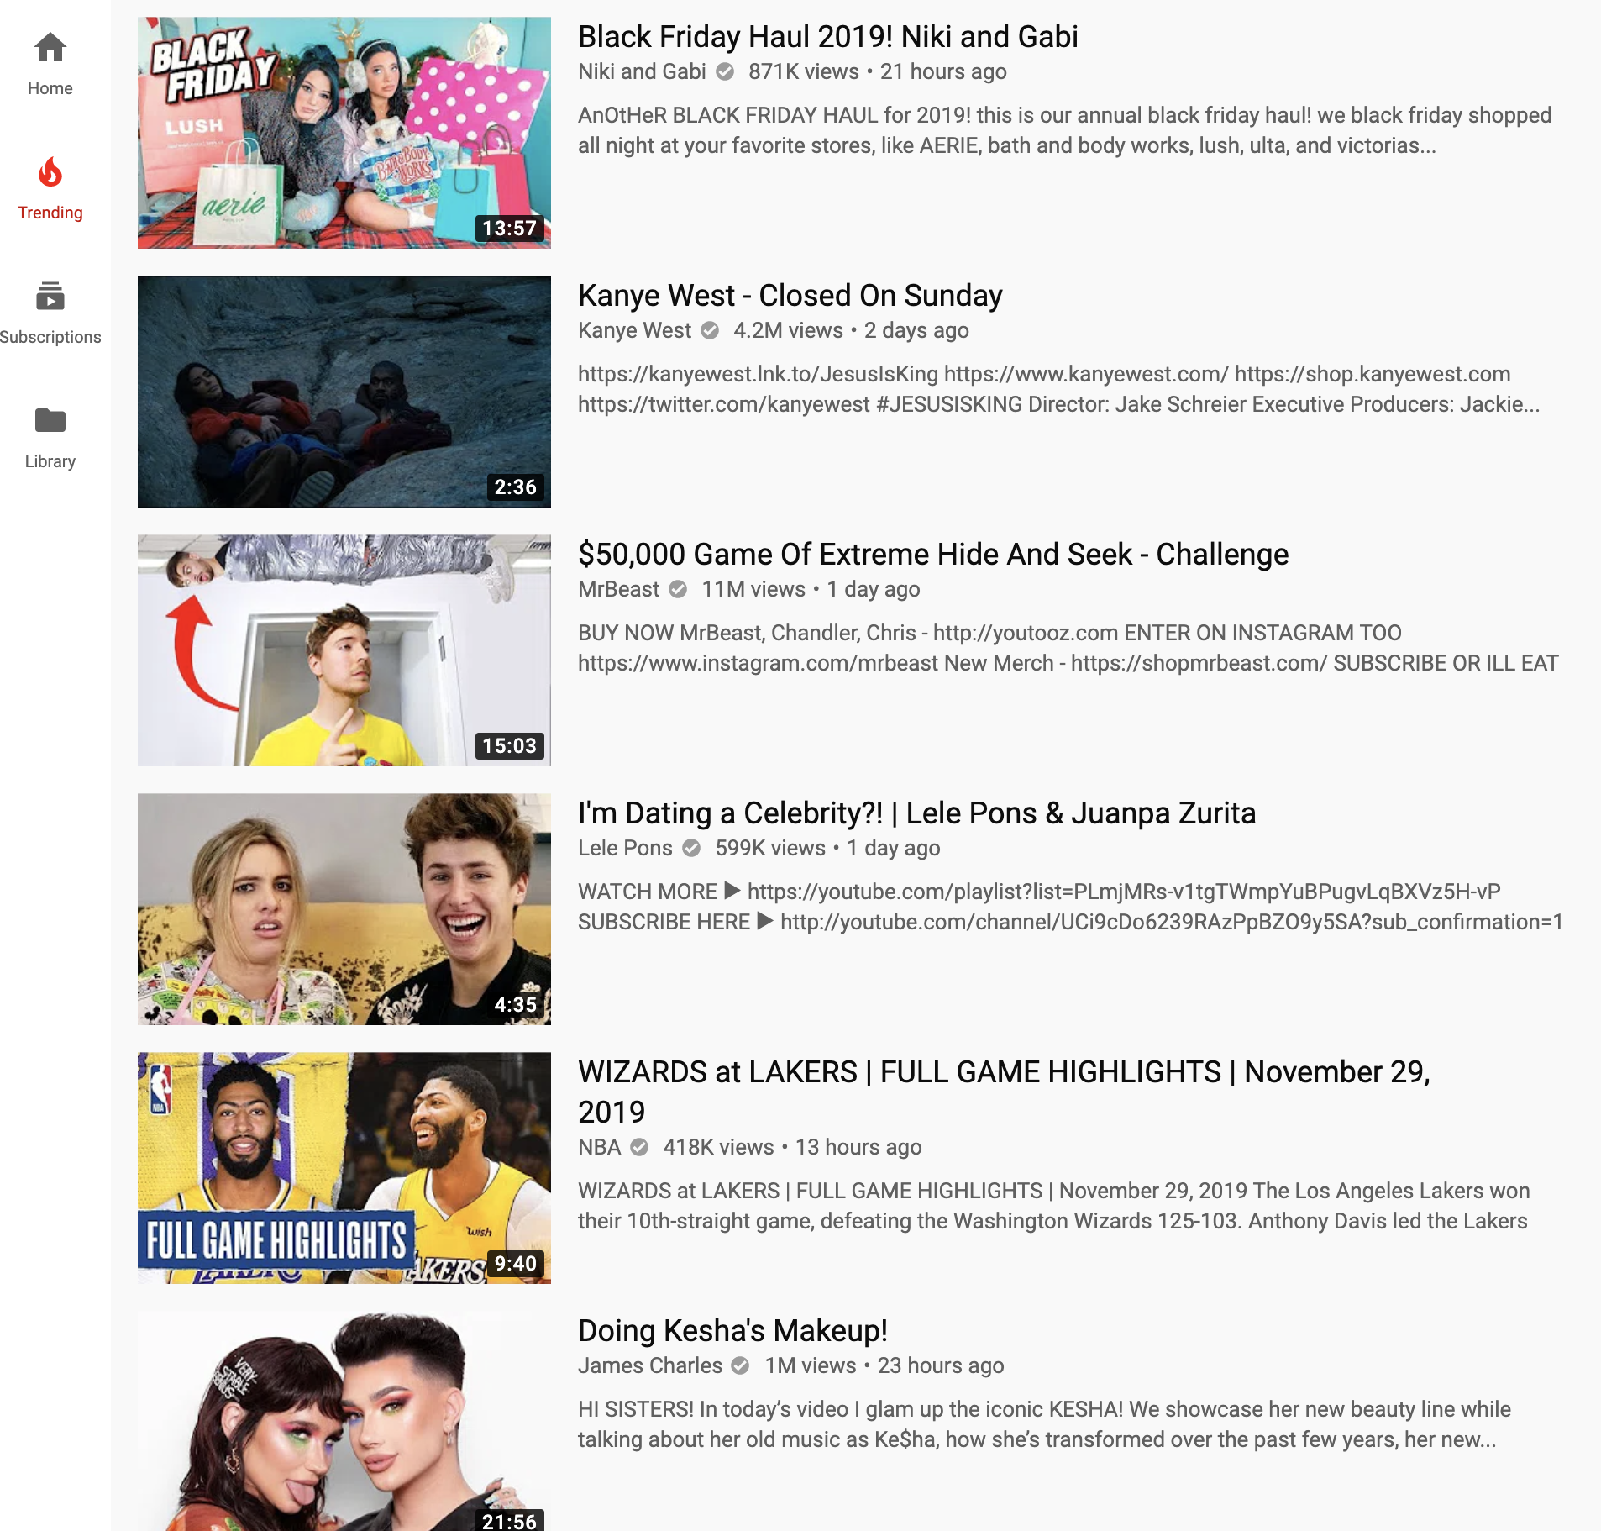
What is the YouTube Trending Page?
The YouTube Trending Page:
The YouTube trending page is a part of the YouTube platform, it is a page that contains the most popular videos that have been recently created. The trending page is updated every 15 minutes, with each update videos can move up, down, or out of the trending page.

Slide 3
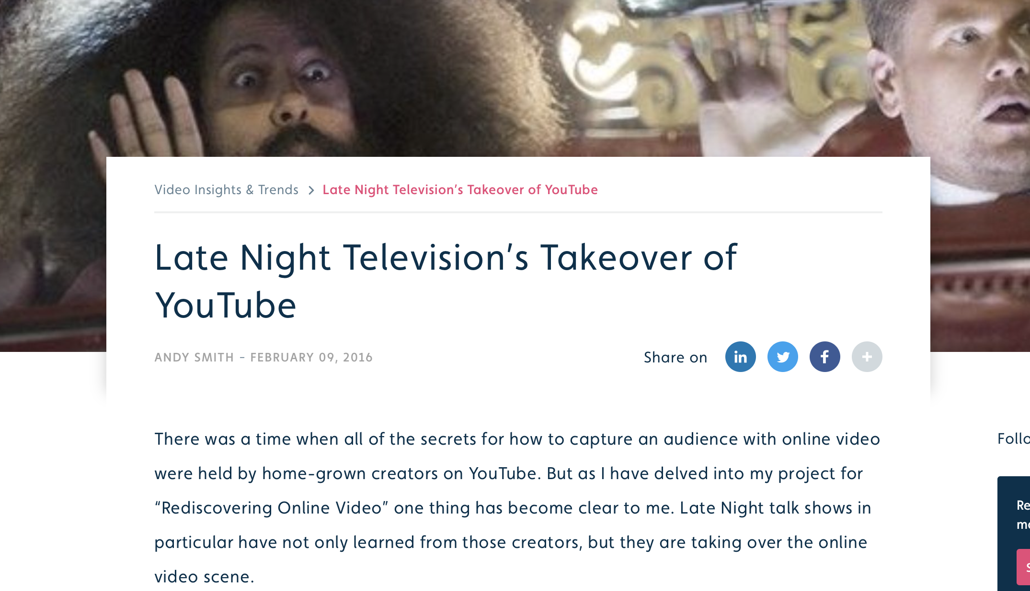
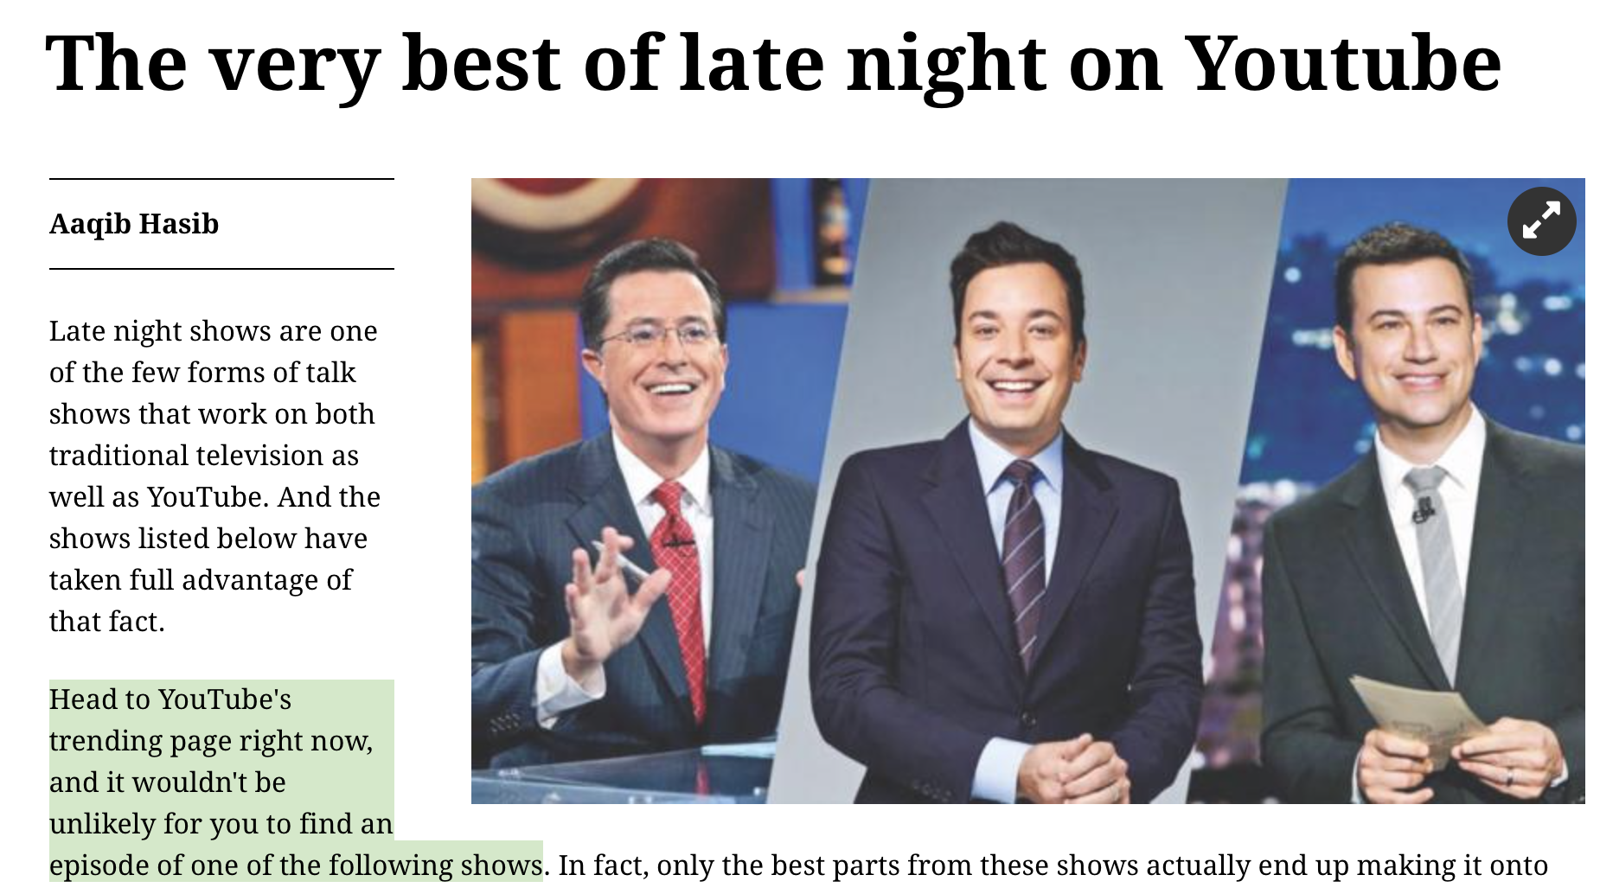
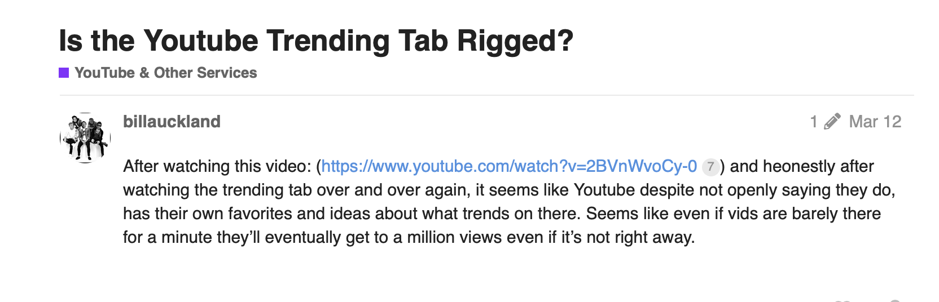
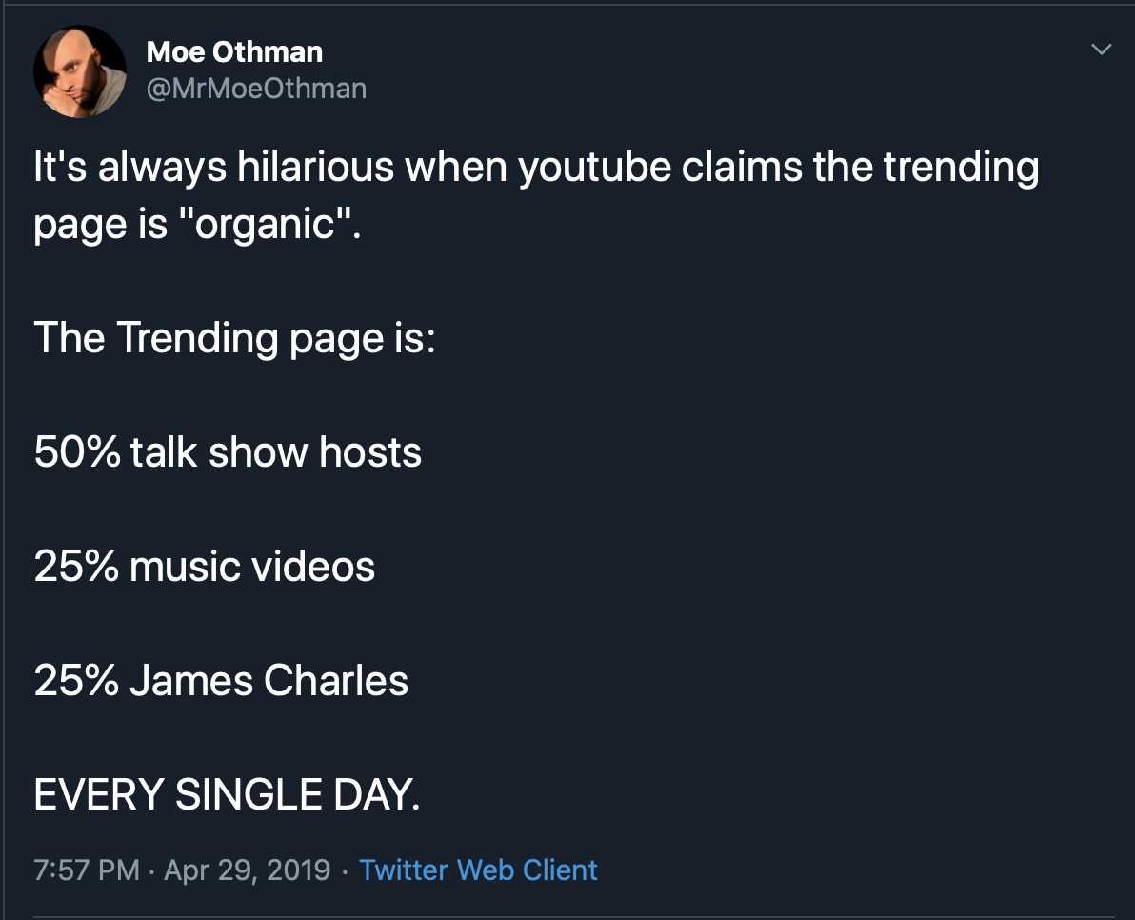

Slide 4
1. Approach

Slide 5
Understanding the Trending Page
Goal:
Determine if there is a bias toward talk-show channels being placed on the trending page
Notes:
WE made a null hyp to analyze this question. The Null is that the system is biased if the number of views per video does not represent the video’s trending status.

Slide 6
2. Methodology

Slide 7
The Null Hypothesis
There is no correlation between views per video and quantity of videos to the likelihood of a video landing on the trending page
Notes:
Null: No correlation between views (how many people watched the video) or proportion of videos (chances of gaining exposure) to likelihood of landing on the trending page. If we notice more views or more videos made by the channels leading to more videos trending, then we reject this hypothesis.

Slide 8
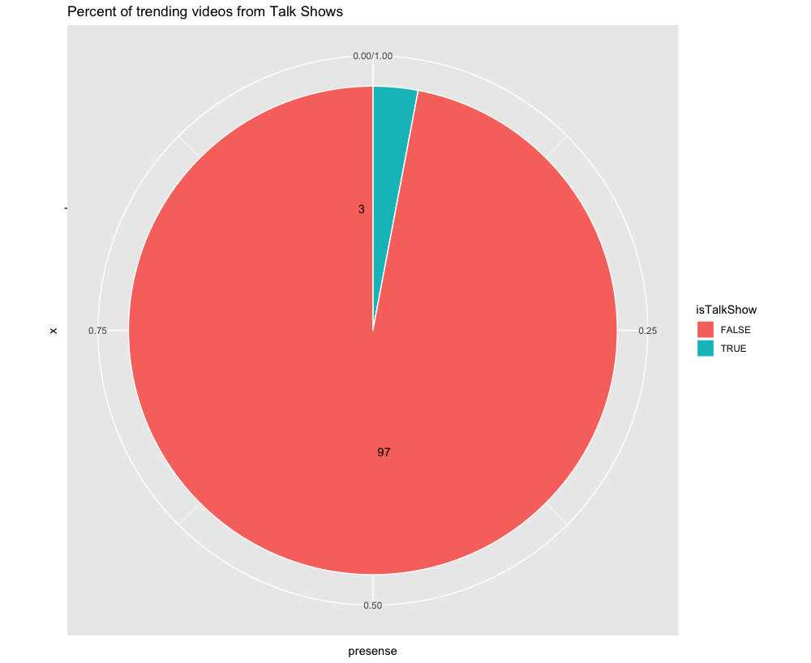
Talk Show Significance on the Trending Page
Despite being only ~.3% of trending channels, Talk Shows make up 3% of all trending videos.

Slide 9
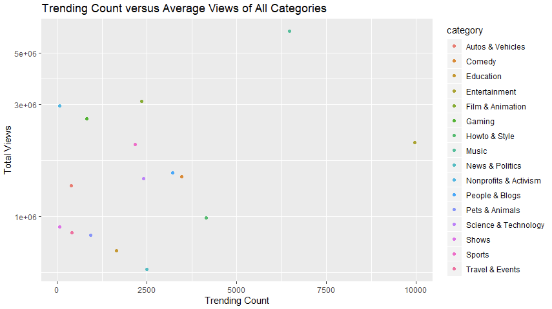
Categories on Trending Page
The Entertainment category is heavily favored on the trending page, not receiving as nearly as many views but being featured on trending more often

Slide 10
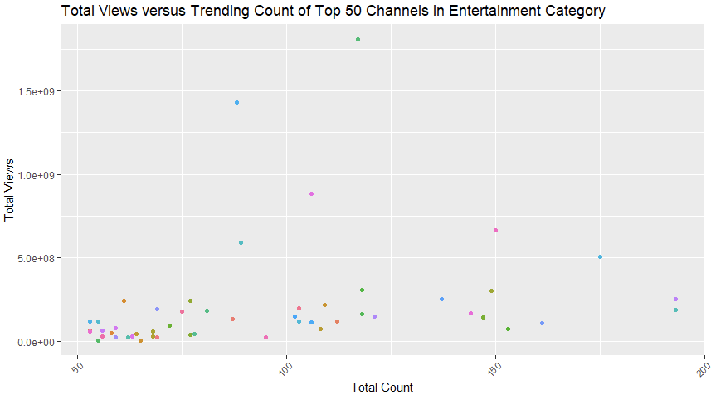
Top 50 Channels Within the Entertainment Category
From this graph we can see that there is no correlation between trending count and view count...however let’s dive a little deeper

Slide 11
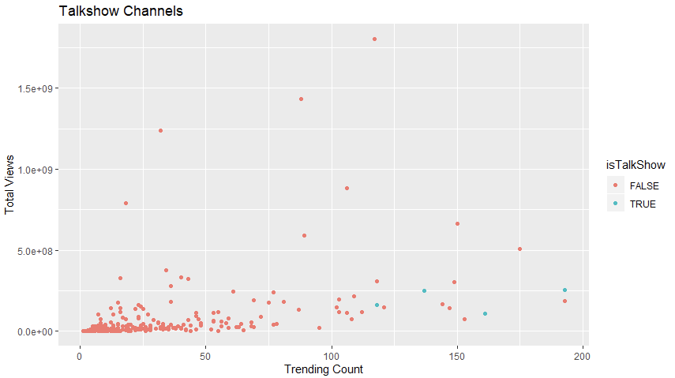
Trending Talk Shows
Using the data points we can see that talk show hosts are highly featured on the trending page although they do not receive many views

Slide 12
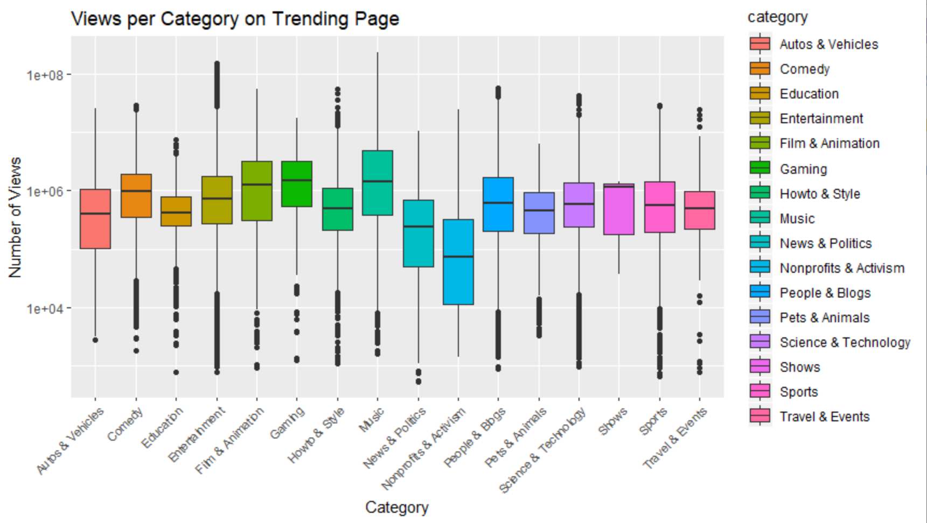
Total number of views for each category
There is no evident category that is shown to attract a significant amount of views more than another category

Slide 13
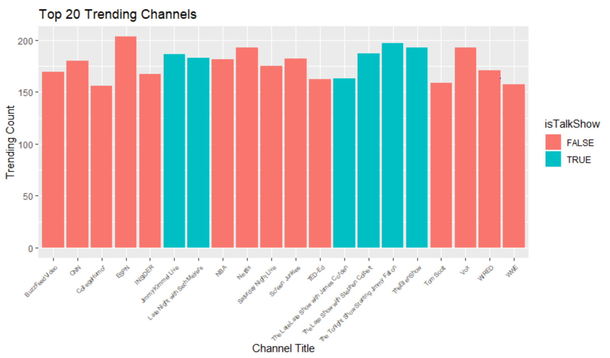
Exploratory Analysis
Broke data into two main elements
Identified 7 Talk-Show Channels
Top 20 Trending Channels

Slide 14
Exploratory Analysis
 | Number of Video Uploads | Total Number of Views | Views per Trending Video | Percent of Videos Trending
TalkShows | 34,118 | 1,557,844,958 | 1,282,176 | 3.5%
Non-TalkShows | 284,051 | 3,146,762,703 | 1,285,442 | .86%
Total number of views for each category
Analyzing the views per trending video and percent of videos trending:
No correlation between views per trending video and percent of videos trending
Can’t disprove the null hypothesis

Slide 15
Views and video count don’t affect a video trending
This means something else is causing talk show videos appear on trending more frequently

Slide 16
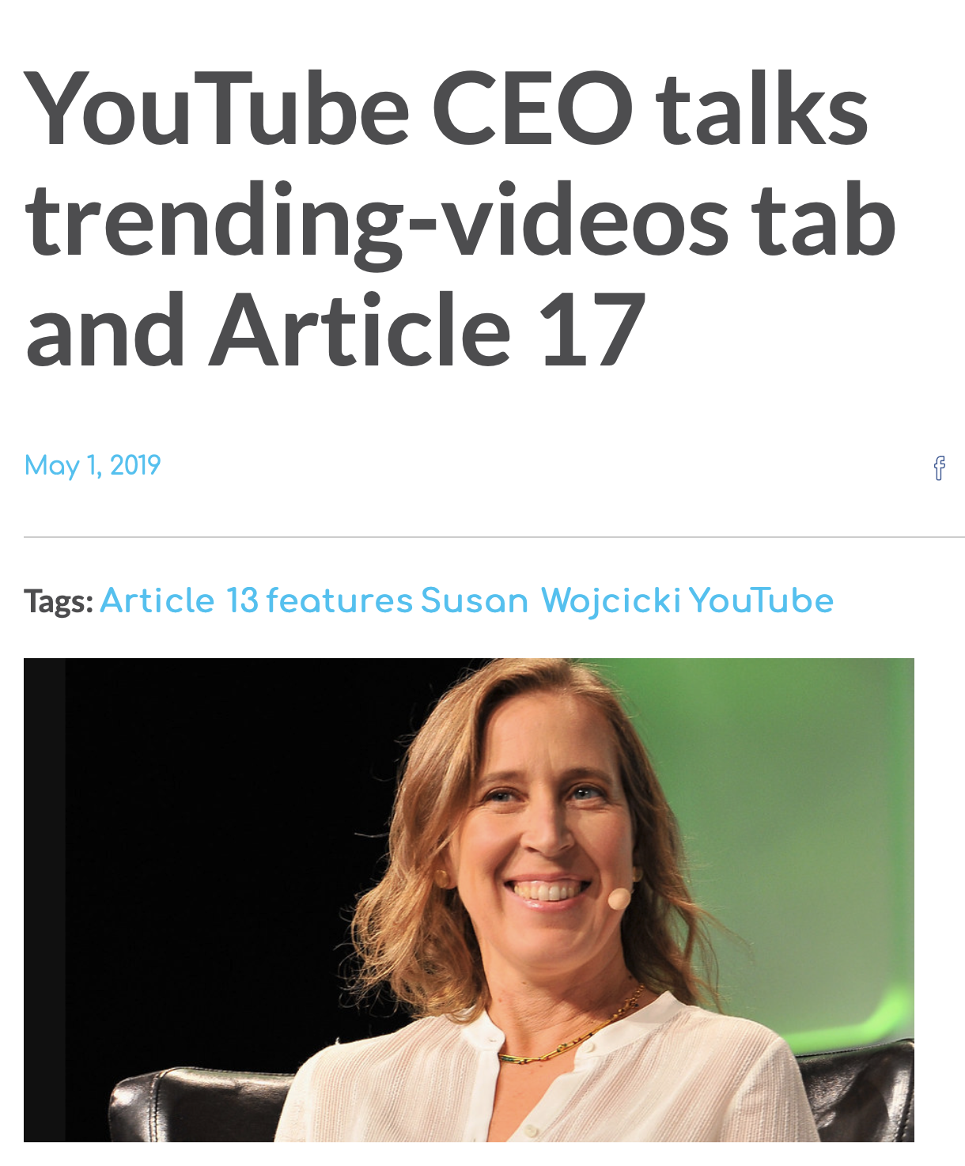
“Going forward, our goal is to have at least half the videos on trending come from YouTubers (with the remainder coming from music and traditional media)”

Slide 17
CREDITS
Special thanks to all the people who made and released these awesome resources for free:
Presentation template by SlidesCarnival
Photographs by Unsplash
Data by Mitchel J on Kaggle

Slide 18
THANKS!
Any questions?

